Slide 1
Education Inequality
by
Long Tran-Thien

Slide 2
introduction
Can we predict ACT scores from certain factors about school, several socioeconomic characteristics of the school district, and basic information about each school
Question to ask:
What variable(s) has the greatest correlation with ACT scores?
To what degree are other variables other than ACT scores have an effect with each other?
What is the best model?

Slide 3
data
This project utilizes two data sets. The primary data set is the EdGap data set from edgap.org This data set from 2016 includes information about average ACT or SAT scores for schools and several socioeconomic characteristics of the school district. The secondary data set is basic information about each school from the National Center for Education Statistics.

Slide 4
Analysis
regression models/Results
Single variables
Multi variables
Looking at R^2, AIC or BIC measurements to tell us how well or not well models predict ACT scores
Best combination of predictors

Slide 5
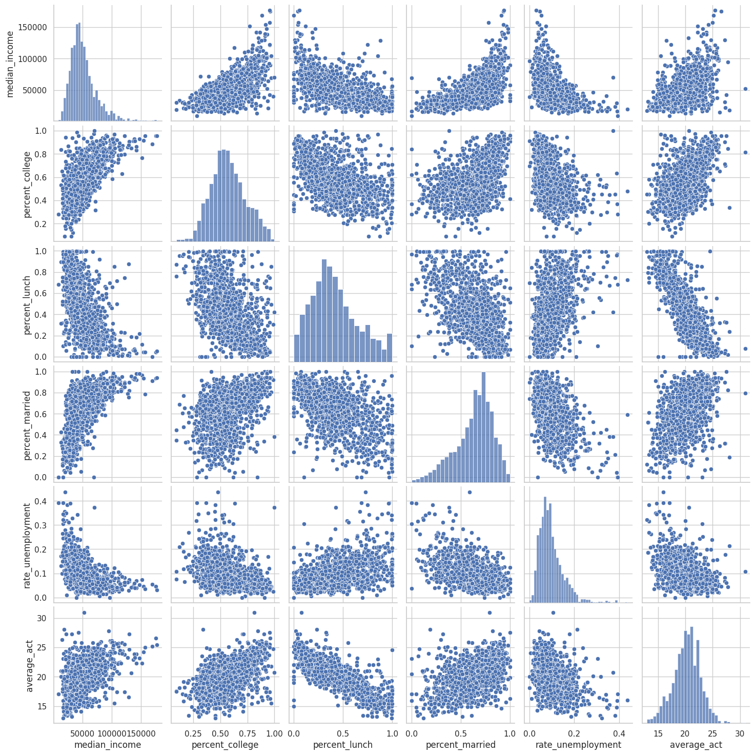
Results – single variable graphs

Slide 6
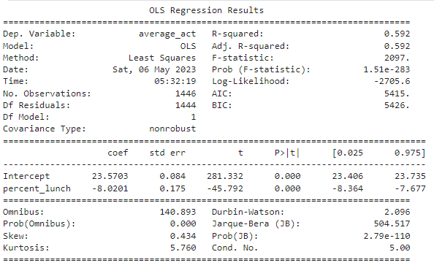
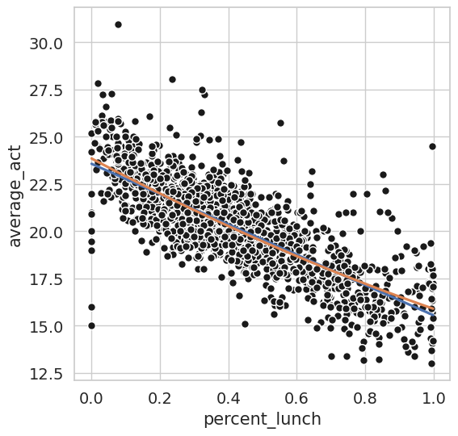
results – regression model (percent_lunch)

Slide 7
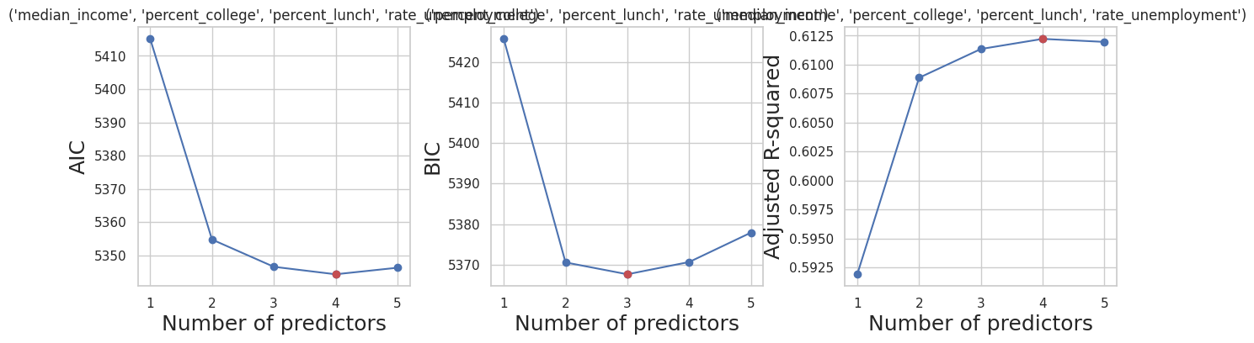
Results – best combination
1 predictor = percent_lunch 2 predictor adds on percent_college 3 predictors adds on rate_unemployment 4 predictors adds on median_income 5 predictors is all of them, adding on percent_married

Slide 8
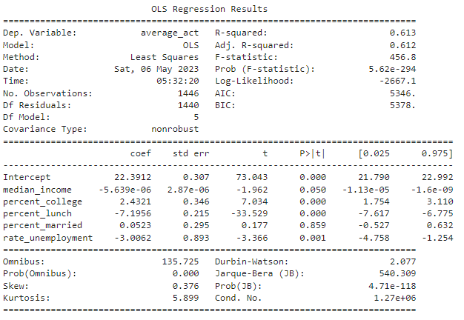
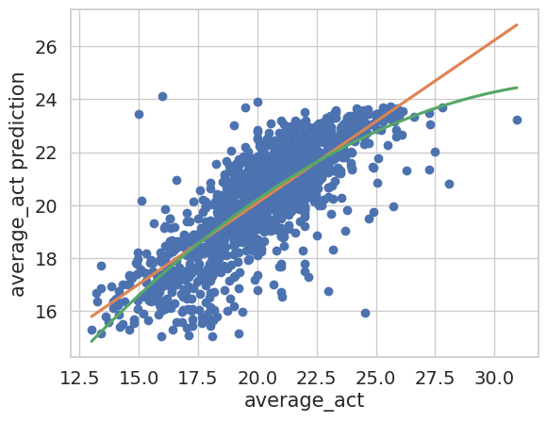
results – regression model (all)

Slide 9
conclusion
in conclusion, to answer the questions, Can we predict average_act from socioeconomic factors? Yes. How well can we predict them? we are able to find combinations of predictors that can help more than other conbinations or single predictors.
what is that best model? depending on what we want to base what is best in terms of using AIC, BIC or r^2, the best model for AIC and r^2 would be the 4 subset 'median_income', 'percent_college', 'percent_lunch', 'rate_unemployment' while BIC would use the 3 subset 'percent_college', 'percent_lunch', 'rate_unemployment'

